Slide 1
Airbnb Investment
By: Hermineh Yeghikian

Slide 2
Question
Which neighborhood should our investor choose to invest in for an Airbnb rental in Washington, D.C.?

Slide 3
Data Cleaning
Created a new column for host experience
Deleted the neighborhood cleansed column and some other columns
Searched for duplicates
Created a new column called “adjusted price” to include the cleaning fee and security deposit

Slide 4
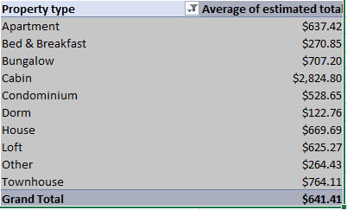
Revenue by property type

Slide 5
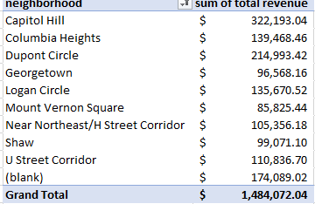
Pivote chart total revenue by neighborhood

Slide 6
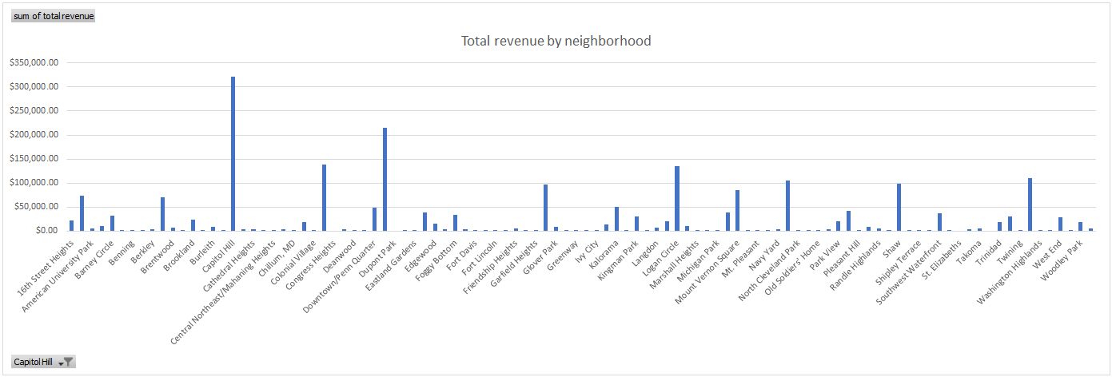
Total revenue by neighborhood

Slide 7
Which neighborhood should our investor invest?
Capitol hill

Slide 8
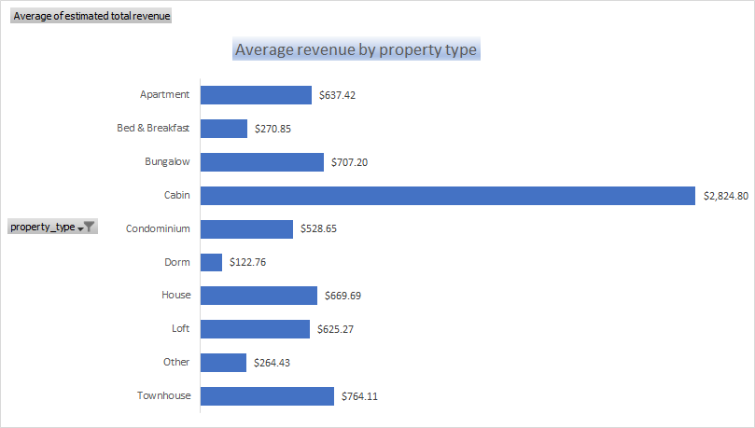
According to the chart, cabin brings in more revenue. Dorm has the lowest revenue

Slide 9
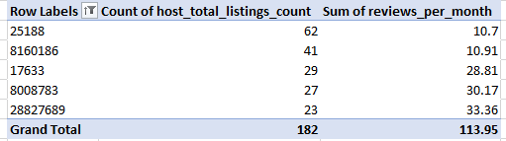
Which host hosts the most listing?

Slide 10
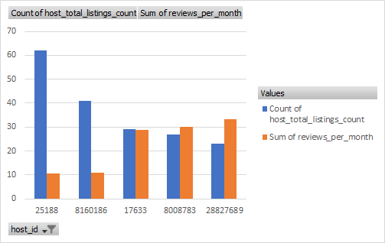
Which host hosts the most listings?

Slide 11
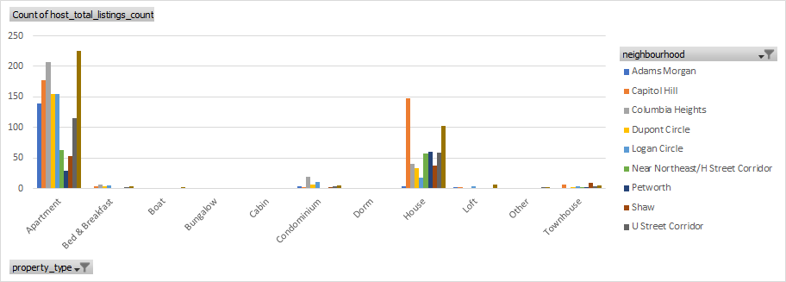
Which neighborhood hosts the most listings?

Slide 12
Which neighborhood hosts the most listings?
U street Corridor lists the most listings for apartments
Capitol hill lists the most listings for houses

Slide 13
Recommendations?
It is better to invest not only in the best neighborhood, also by property type
Amenities and attractions nearby should also be considered and will affect the amount of revenue the hosts receive

